Slide 1
NAME OF THE PROJECT Housing Price Prediction
Submitted by:
Arshi Maitra

Slide 2
Acknowledgement:
This project has been completed with the help of training documents and live classes recordings from Data Trained Education. Few helps on coding have also been taken from few data science websites like Toward Data Science, Geek for Geeks, Stack Overflow.

Slide 3
INTRODUCTION
House price prediction can help the developer determine the selling price of a house and can help the customer to arrange the right time to purchase a house. There are three factors that influence the price of a house which include physical conditions, concept and location. Traditional house price prediction is based on cost and sale price comparison lacking of an accepted standard and a certification process. Therefore, the availability of a house price prediction model helps fill up an important information gap and improve the efficiency of the real estate market. Data science comes as a very important tool to solve problems in the domain to help the companies increase their overall revenue, profits, improving their marketing strategies and focusing on changing trends in house sales and purchases. Predictive modelling, Market mix modelling, recommendation systems are some of the machine learning techniques used for achieving the business goals for housing companies.
Below is the dataset available from the sale of houses in Australia as a US-based housing company named Surprise Housing has decided to enter the Australian market. The company uses data analytics to purchase houses at a price below their actual values and flip them at a higher price.
The main goal of the project will be to determine the following:
To determine the price of houses in Australia
To understand the factors that are responsible for the price of a house

Slide 4
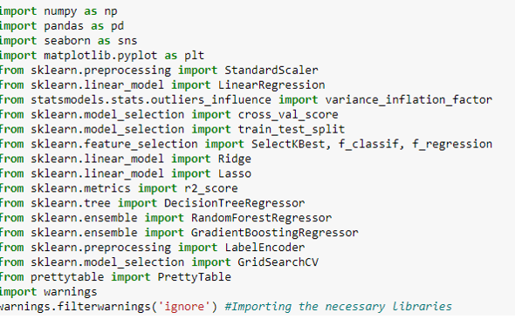
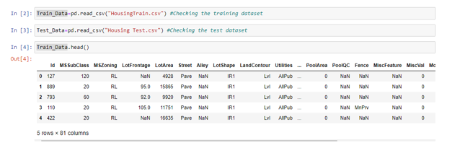
Analytical Problem Framing
Importing of necessary libraries:
Data Preprocessing/Data Cleaning:
Both the train and test set has been loaded

Slide 5
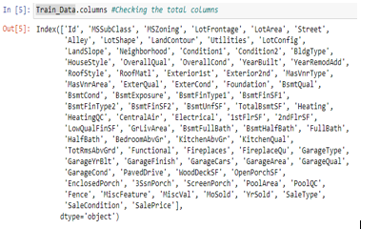
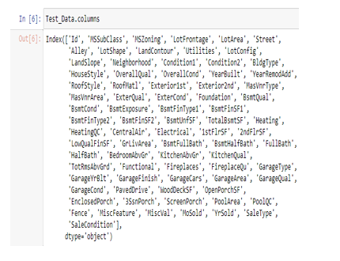
Going through the columns of both the data:

Slide 6
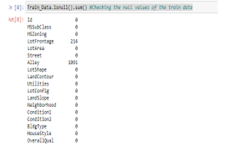
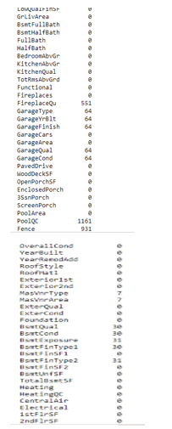
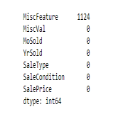
Checking the null values from Train and Test data:

Slide 7

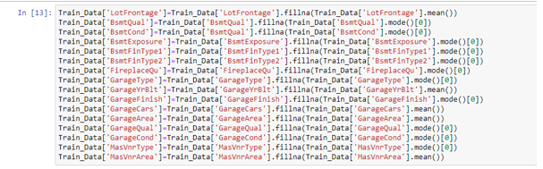

Dropping the null values as well as filling up the null values:
Data Imputation:
Data Imputation:
Encoding the object data types:

Slide 8
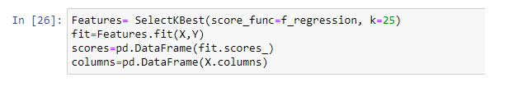
Selecting K Best feature selection method: As we had 81 columns hence it was difficult to train the model with all the 80 features. Therefore K Best feature selection method has been utilised in order to get the best 25 features in comparison to 80.

Slide 9
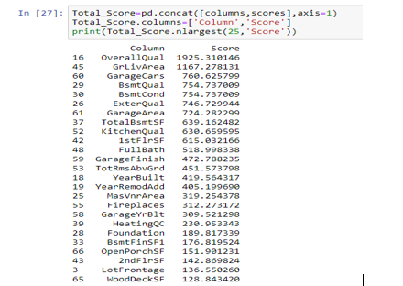
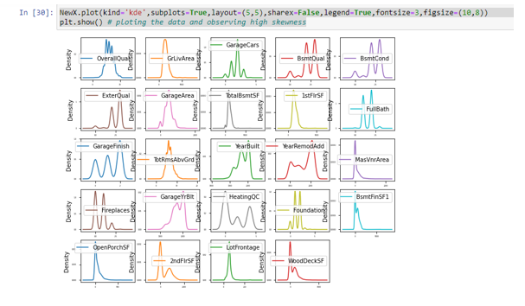
Checking the scores:
Now we received 25 best features
Checking Data Skewness :

Slide 10
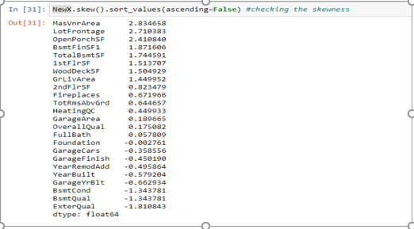
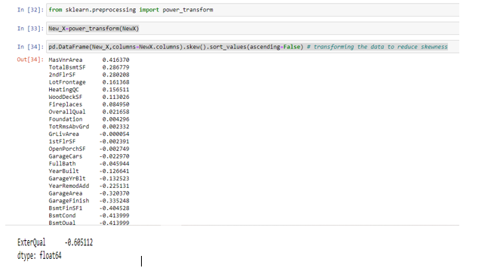
Skewness Score:
Importing Power Transformation.
As the data is skewed it will affect the prediction score. Therefore data has to be transformed before taking any further action:

Slide 11
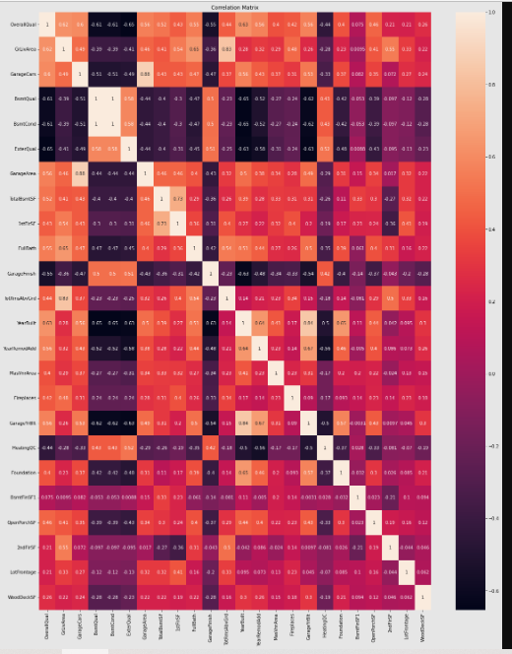
Checking Multicollinearity: 1. Heat Map:

Slide 12

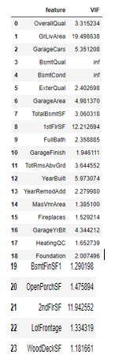
From the heat map it can be observed that basement quality and basement condition has 100 % multicollinearity issue. Therefore it needs to be dropped, lets check via another metric that is VIF. 2) VIF

Slide 13
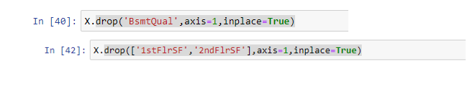
As concluded from the heat map above, Basement Quality and basement condition has 100 % multicollinearity issue. Along with that first floor square feet, second floor squarefeet as well as Ground level above squarefeet also has multicollinearity issue. It can be said be Ground level above squarefeet is the same data as first floor square feet, second floor squarefeet. Therefore Basement Quality, first floor square feet and second floor squarefeet are dropped off in the train and test data.

Slide 14
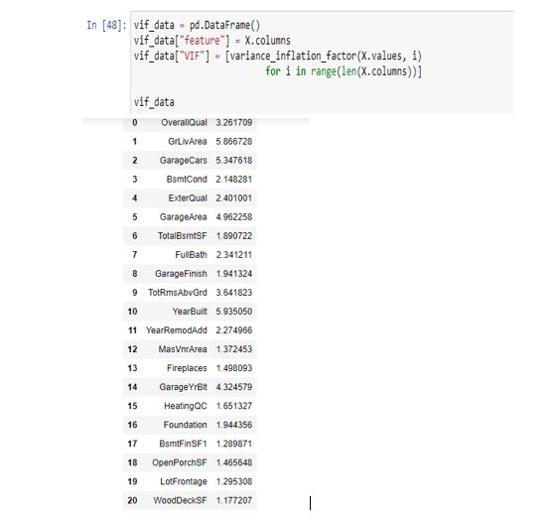
Checking the final VIF Score:
Therefore, the issue of multicollinearity has now been resolved.

Slide 15
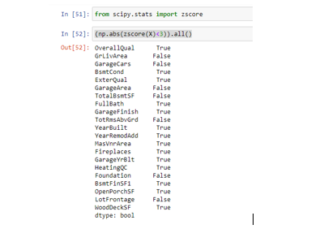
Detecting Outliers: Zscore method has been applied to remove the outliers in the data.

Slide 16
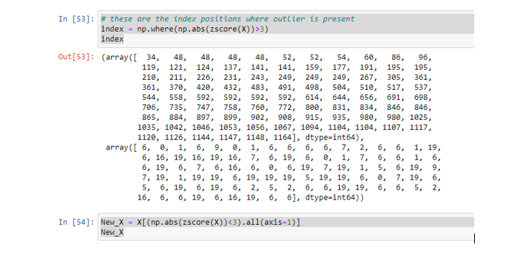
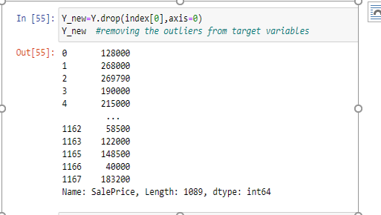
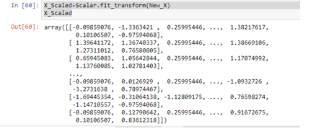
Outliers has been removed and values without outliers have been stored in a different variable.
Scaling the data:

Slide 17
Model/s Development and Evaluation
(Linear Regression, Decision Tree Regressor, Random Forest Regressor and Gradient Boosting Regressor)

Slide 18
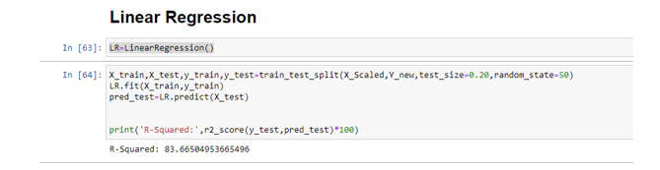
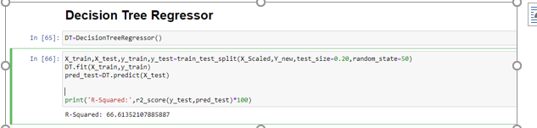
Linear Regression: 83.66%
Decision Tree Regressor: 66.61%

Slide 19
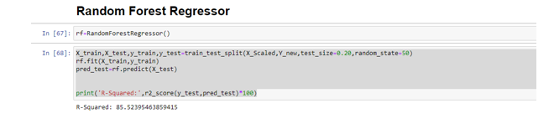
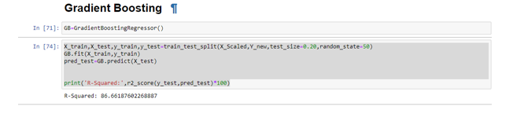
Random Forest Regressor:85.52%
Gradient Boosting Regressor:86.66%

Slide 20
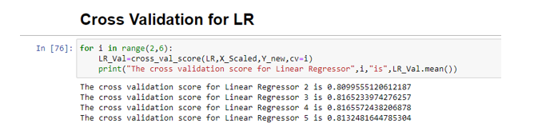
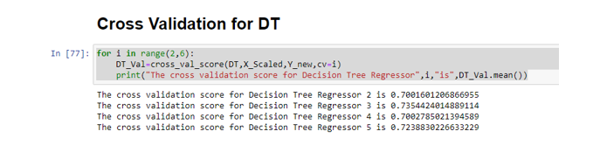
After getting the r squared scores for all the models, it needs to be checked whether any one of them are overfitted, hence cross validation technique has been used. Cross Validation for LR:
Cross Validation for DT

Slide 21
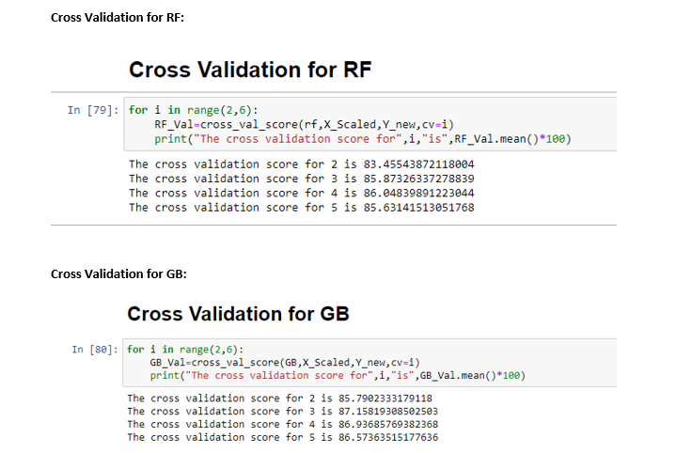
As none of the models are overfitted, and based on the r squared score and cross validation scores, Gradient Boosting Regressor model is best for this dataset.

Slide 22
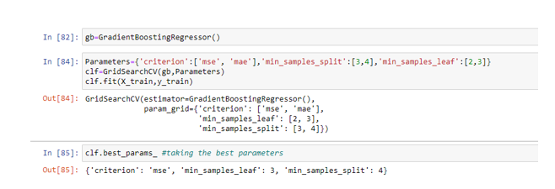
Hypertuning Parameter: As gradient boosting has been termed as the best model for this dataset. Lets try to tune the parameters to see if the score can be increased. Trying first with best parameter by Grid Search CV method:
Now reinitialising the best parameters and checking the score:

Slide 23
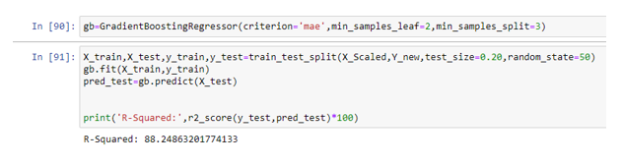
Trying different parameters other than Grid Search CV.
Score increased, thereby saving the model

Slide 24
Conclusion

Slide 25
Key Findings: Going through the data, it can be concluded that the following are the main 25 parameters that influence the price of houses in Australia. With the help of these details Surprise Housing will be able to manipulate the price and enter the Australian market. Overall Qual Above grade (ground) living area square feet Garage Cars Basement Quality Basement Condition External Quality GarageArea Total Basement Square feet Kitchen Quality First Floor Squarefeet Full Bath Garage Finish Total rooms above grade (does not include bathrooms) Year on which House wasBuilt Year on which renovation was added Masonry veneer area in square feet Fire places Year on which garage was built Heating QC Foundation Type 1 finished square feet Open Porch square feet 2nd Flr SF Lot Frontage WoodDeck SF

